Slide 1
CHAPTER-05
FRANCIS TURBINE
SUB: FLUIDS MECHANICS &
MACHINERY
Prepared By:
Ms.Nilesha U.Patil

Slide 2
Program :
Mechanical Engineering
Course:
Fluid Mechanics & Machinery
CO-Select various types of turbine under specified condition.

Slide 3
Introduction
A turbine is a rotary mechanical device that extracts energy from a fluid flow and converts it into useful work.
Turbines are used in boat propulsion systems, hydroelectric power generators, and jet aircraft engines.

Slide 4
Basic Types of Turbine
Steam Turbine
Water Turbine
Wind Turbine

Slide 5
Types Based Energy Used
Impulse turbine : Only kinetic energy of water is used to drive turbine.
Eg.Pelton Turbine
Reaction turbine : Kinetic energy as well as Pressure energy of water is used to drive turbine.
Eg.Francis Turbine

Slide 6
Introduction
Francis turbines are the most common water turbine in use today.
They operate in a water head from 10 to 650 meters (33 to 2,133 feet).
They are primarily used for electrical power production.
The turbine powered generator power output generally ranges from 10 to 750 megawatts

Slide 7
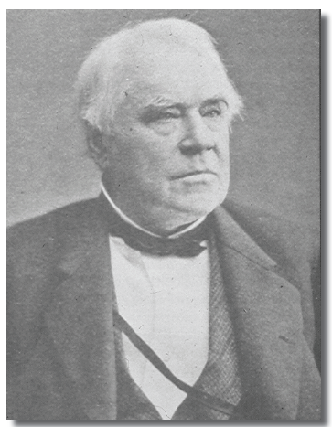
Sir James B. France
This turbine was invented by Sir James B. France in Lowell, Massachusetts, U.S.A.
Studying the Boyden turbine ,Francis was able to redesign it to increase efficiency.
Boyden Turbine could achieve a 65 percent efficiency.
So, James France redesigned this turbine and new turbine with 88% efficiency was invented.
This was known as ‘Francis turbine’.

Slide 8
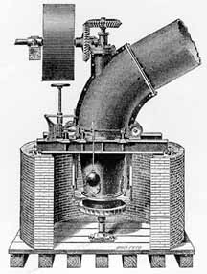
The Boyden Turbine

Slide 9
Francis Turbine
It is an inward flow reaction turbine of mixed flow type , in which ,water enters the runner radially at its outer peripheri and leaves axially at its centre.

Slide 10
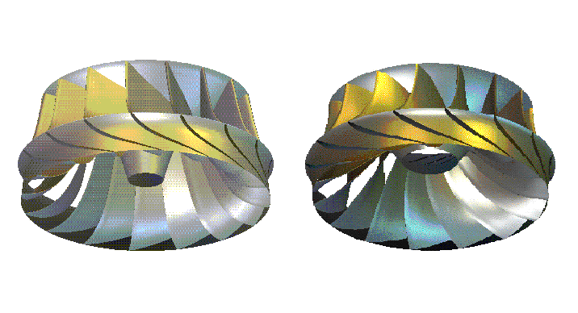
The Francis Runner
Traditional runner
X blade runner

Slide 11
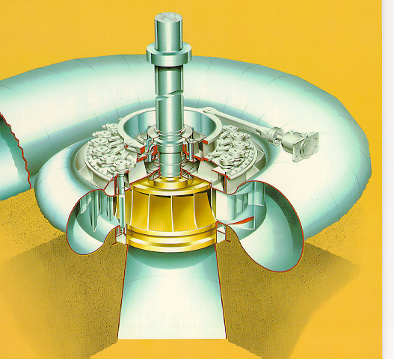
The Francis Turbine

Slide 12
Working
Penstock: It is a large size conduit which conveys water from the upstream to the dam/reservoir to the turbine runner.
Spiral Casing: It constitutes a closed passage whose cross-sectional area gradually decreases along the flow direction; area is maximum at inlet and nearly zero at exit.
Guide Vanes: These vanes direct the water on to the runner at an angle appropriate to the design, the motion of them is given by means of hand wheel or by a governor.
Governing Mechanism: It changes the position of the guide blades/vanes to affect a variation in water flow rate, when the load conditions on the turbine change.
Runner and Runner Blades: The driving force on the runner is both due to impulse and reaction effect. The number of runner blades usually varies between 16 to 24.
Draft Tube: It is gradually expanding tube which discharges water, passing through the runner to the tail race.
Hydraulic efficiency varies between 85-90%.

Slide 13
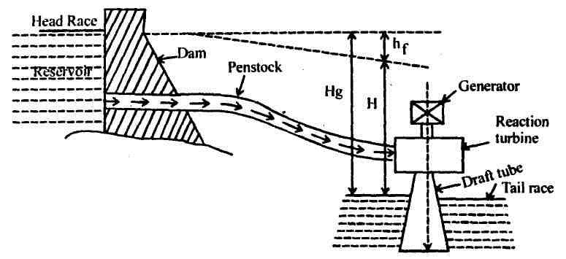
Francis Turbine Power Plant : A Continuous Hydraulic System

Slide 14
Parts of A Francis Turbine

Slide 15
Water particle
Water from spiral casing

Slide 16
Runner inlet (Φ 0.870m)
Guide vane outlet for designα) (Φ 0.913m)
Closed
Position
Max. Opening Position

Slide 17
Operation of Guide Vanes
.

Slide 18
Hydraulic efficiency of Francis Hydraulic System

Slide 19
Advantages
It is a most widely used turbine in world (about 70-80%).
Effective use of water pressure as well as velocity.
It is American standard turbine.
Very good efficiency(80-94%).

Slide 20
Disadvantages
Cost is High.
Due to its complex design and large number of moving parts, maintenance and repair is difficult and costly.
It is applicable to flow of medium head only.

Slide 21
Recent Advancements:
New types of designs are developed to reduce cost and complexity of mechanism.
Modified turbine include Inline Linkless Francis Turbine, Cross-flow Turbine,etc.
These new turbine require less space, simplified designs, less moving parts, etc.

Slide 22
Thank You

